Slide 1
Building on the Context of Learners’ Lives
Falon Eke and Emily Tomita
Intergenerational Literacy Program
Chelsea, MA

Slide 2
Who We Are
Falon
Instructor of Family Literacy Children’s class
Instructor of Intermediate level ESOL class
Emily
Instructor of multi-level ESOL Family Literacy class
Instructor of Beginner level ESOL class

Slide 4
Before we begin...
1. What’s your name?
2. What program are you from?
3. What do you like most about teaching?

Slide 5
Agenda
The concept of family literacy
Some challenges and goals of ESOL learners
The importance of authentic materials
Examples of activities
Q&A

Slide 6
The Intergenerational Literacy Program
It began in 1989 as one element of Boston University/Chelsea Public Schools Partnership
Our major goals:
To improve the English literacy of parents
To support the literacy development and academic success of their children
Notes:
When the ILP began, its main focus was “family literacy”. However over time, the needs of our population changed (Chelsea’s immigrant population increased), so the focus of our program changed to meet those needs. It shifted more towards an ESOL approach to family literacy. **Talk about the population we work with**
Our parents come from very varied educational backgrounds (ranging from little to no formal education, college-educated). But formal schooling in their countries is usually different than what is offered in the US, so we try to offer them as much support and advice on how to effectively be a part of their children’s education (talking about the common core, PARCC, author studies).

Slide 7
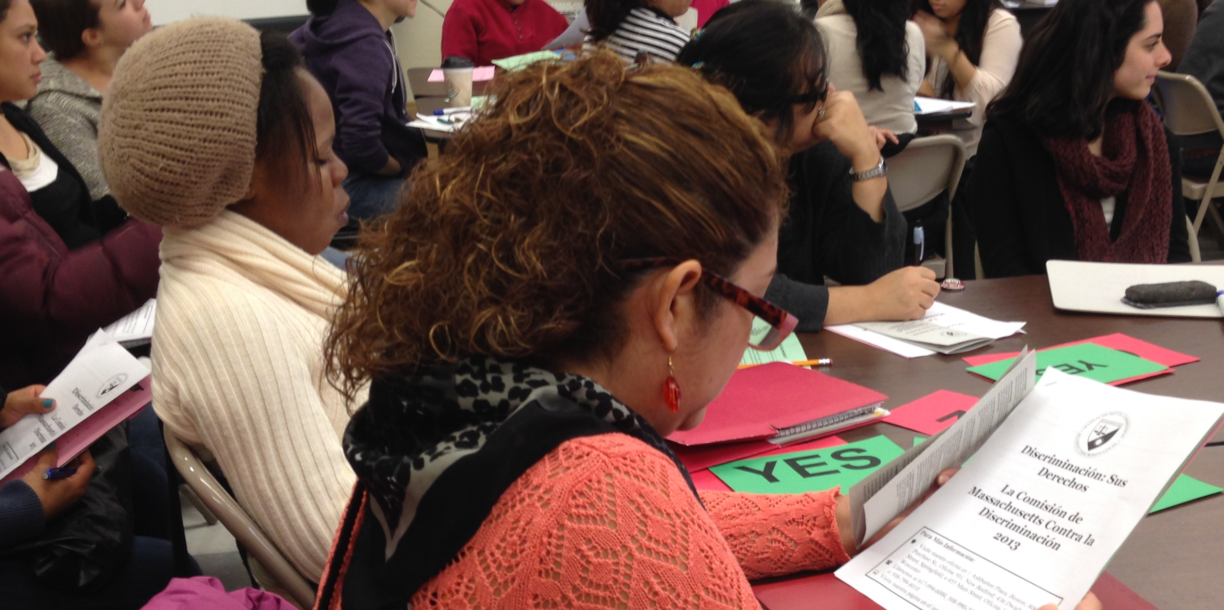
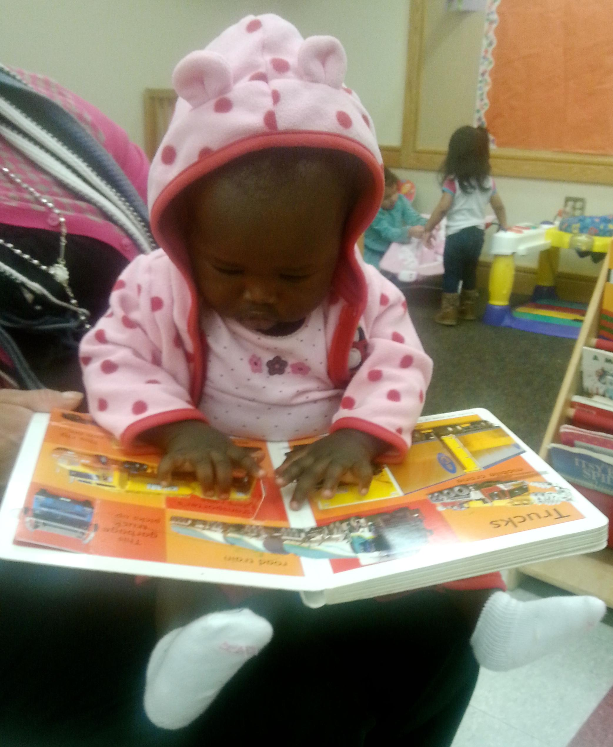
Family Literacy
Definition: “Parents actively helping themselves and their children to become lifelong learners through a variety of daily activities.”
-Project READ Literacy Network
Notes:
Family literacy is the context in which we teach all our classes, mainly because many of our learners are parents/grandparents/people who interact with children often etc. We do focus on family literacy, but we also teach within other contexts of our learners’ lives as parents (jobs, doctors’ appts etc.)

Slide 8
Family Literacy at the ILP
Two different classes
Parents
Children
Parents’ lessons support the literacy development of their children
Notes:
**We tend to have good attendance because we have childcare.** Parents coming to school with their children (and sometimes their parents - intergenerational!)
we have both children and adult classes. we try to connect our themes, so the parents’ lessons support that of their children.

Slide 9
ESOL Learners
Challenges
Goals
Speaking and understanding English
Literacy
Understanding and filling out forms
Finding employment
Understanding basic traffic and transportation rules
Supporting children academically
Speaking and understanding English
Reading with comprehension
Accurately communicating ideas through writing
Helping children with their homework
Finding better-paying jobs
Being able to independently manage their finances

Slide 10
Authentic Activities
Tasks in the classroom are contextualized and connected to real-life situations
Purcell-Gates, Degener, Jacobson, and Soler, (2002): Adults who attended programs or classes with more authentic literacy activities reported:
Reading and writing more often outside of the classroom
Reading and writing more complex texts
Holistic, integrated instruction at all levels
Scaffolding (WPW)
Notes:
We must “address the needs and interests of students, engaging them in authentic, real-life tasks, allowing them ownership of the curriculum” (Felix, 2005, p. 88).
When have you ever needed to complete a worksheet in your outside real life? Filling out worksheets is not a challenge or a goal that any of our learners have.

Slide 11
Differentiation
With lower-level learners, you can use the same authentic materials with an emphasis on building literacy skills and strategies
Ex. low-literate learners can focus on building phonological skills
Goal: take something away, not everything
Model, model, model
Notes:
On average, our learners have about 8 years of schooling (some have 0, some have college). Authentic materials can be difficult to differentiate for lower-level learners, but that doesn’t mean you shouldn’t.
Talk about literacy development as a “revolution in the brain”. Need to learn the motions of reading and interacting with a text.
Bring white boards
Constructivism
Reference low-lit. curriculum
Show “Sound-symbol” movie (3 min.)

Slide 12
Try it out:
Thematic area: Crime and public safety
Article: “What We Know about Crime in the United States”
Brainstorm: Think of 2-3 ways to make this article engaging and accessible.

Slide 13
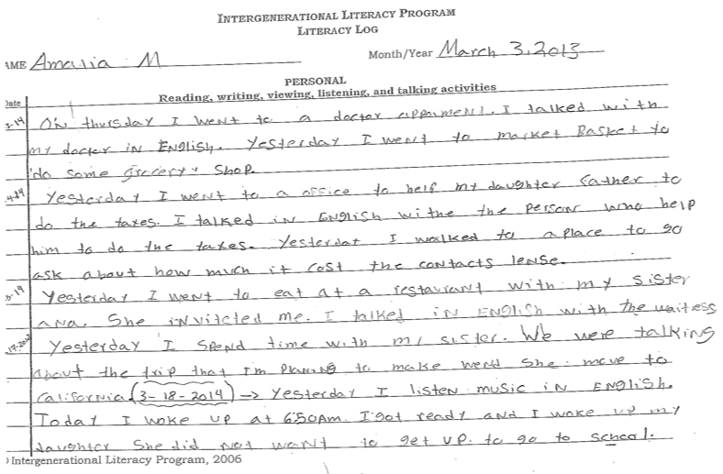
Activity ideas: Literacy logs

Slide 14
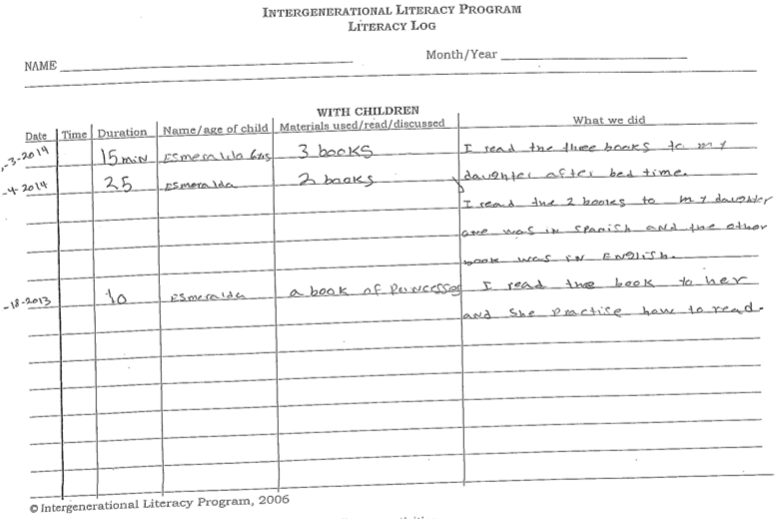
Activity ideas: Literacy logs

Slide 15
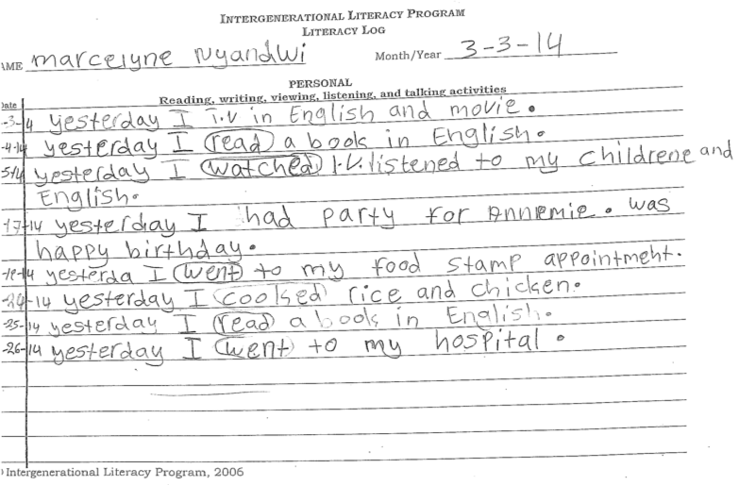
Activity ideas: Literacy logs

Slide 16
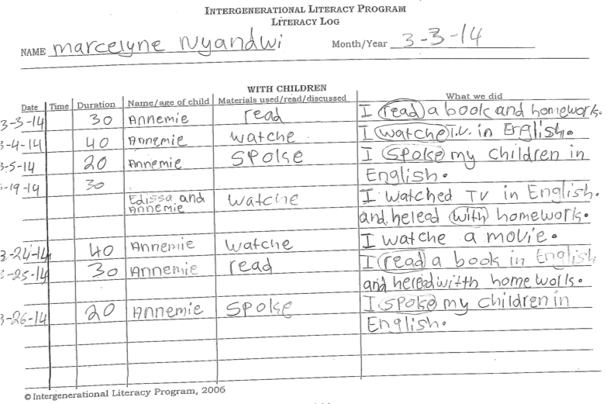
Activity ideas: Literacy logs

Slide 17
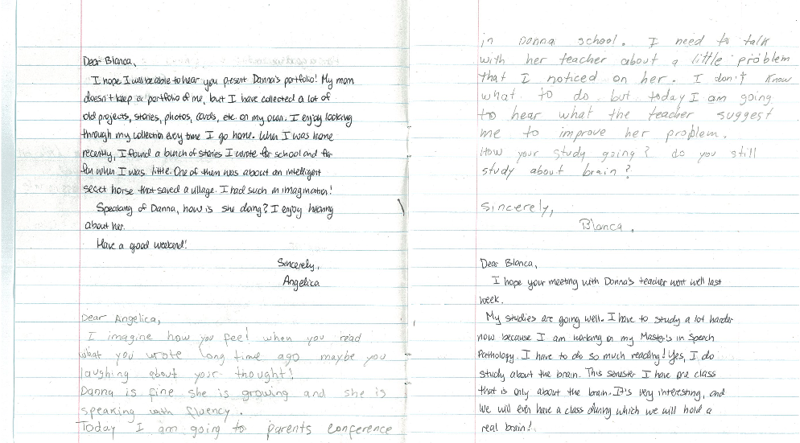
Activity ideas: Dialogue journals

Slide 18
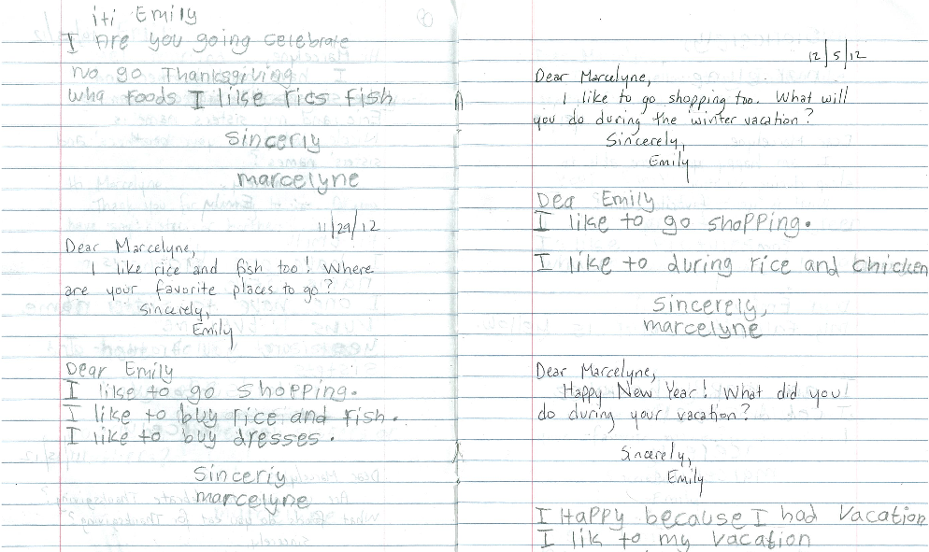
Activity ideas: Dialogue journals

Slide 19
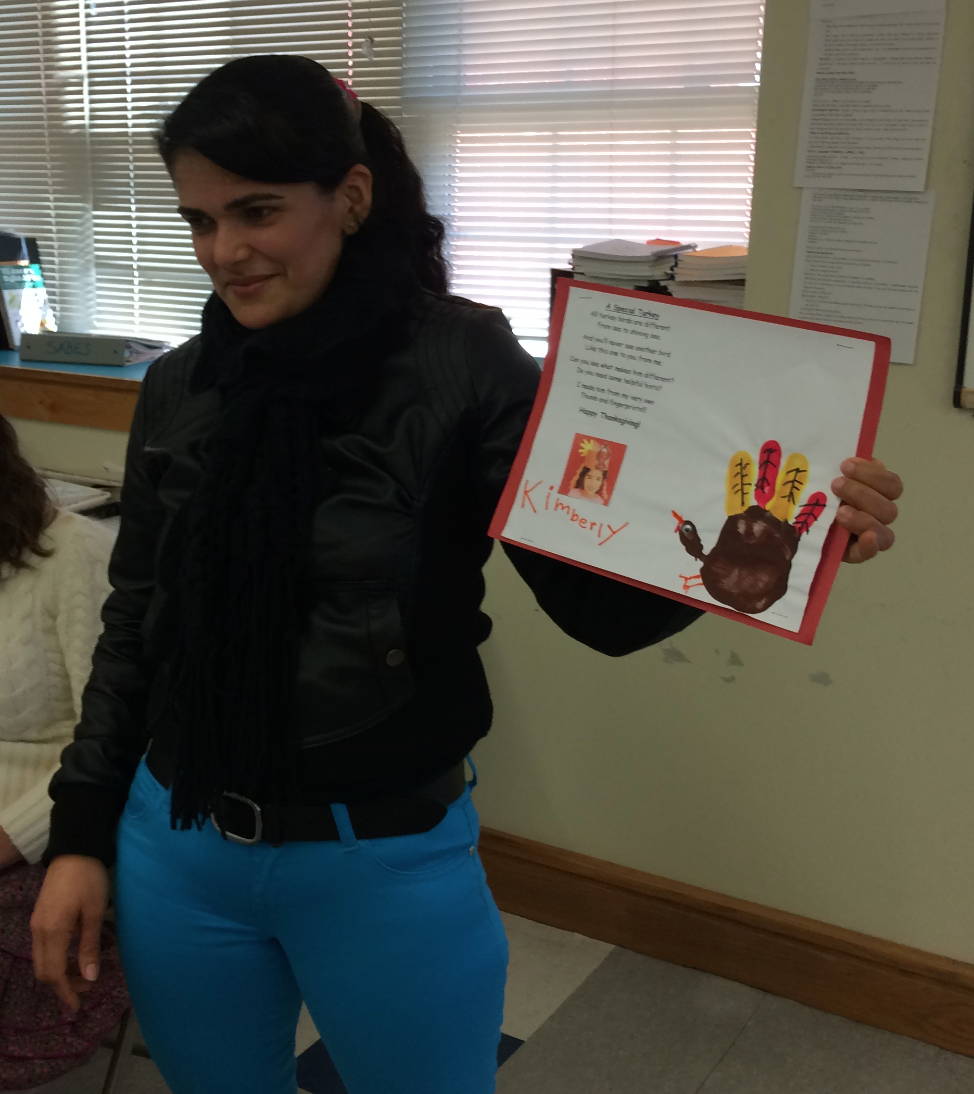
Activity ideas: Portfolio presentation

Slide 20
Activity ideas: Book of the Week
Notes:
Falon talks about how we choose the book of the week

Slide 21
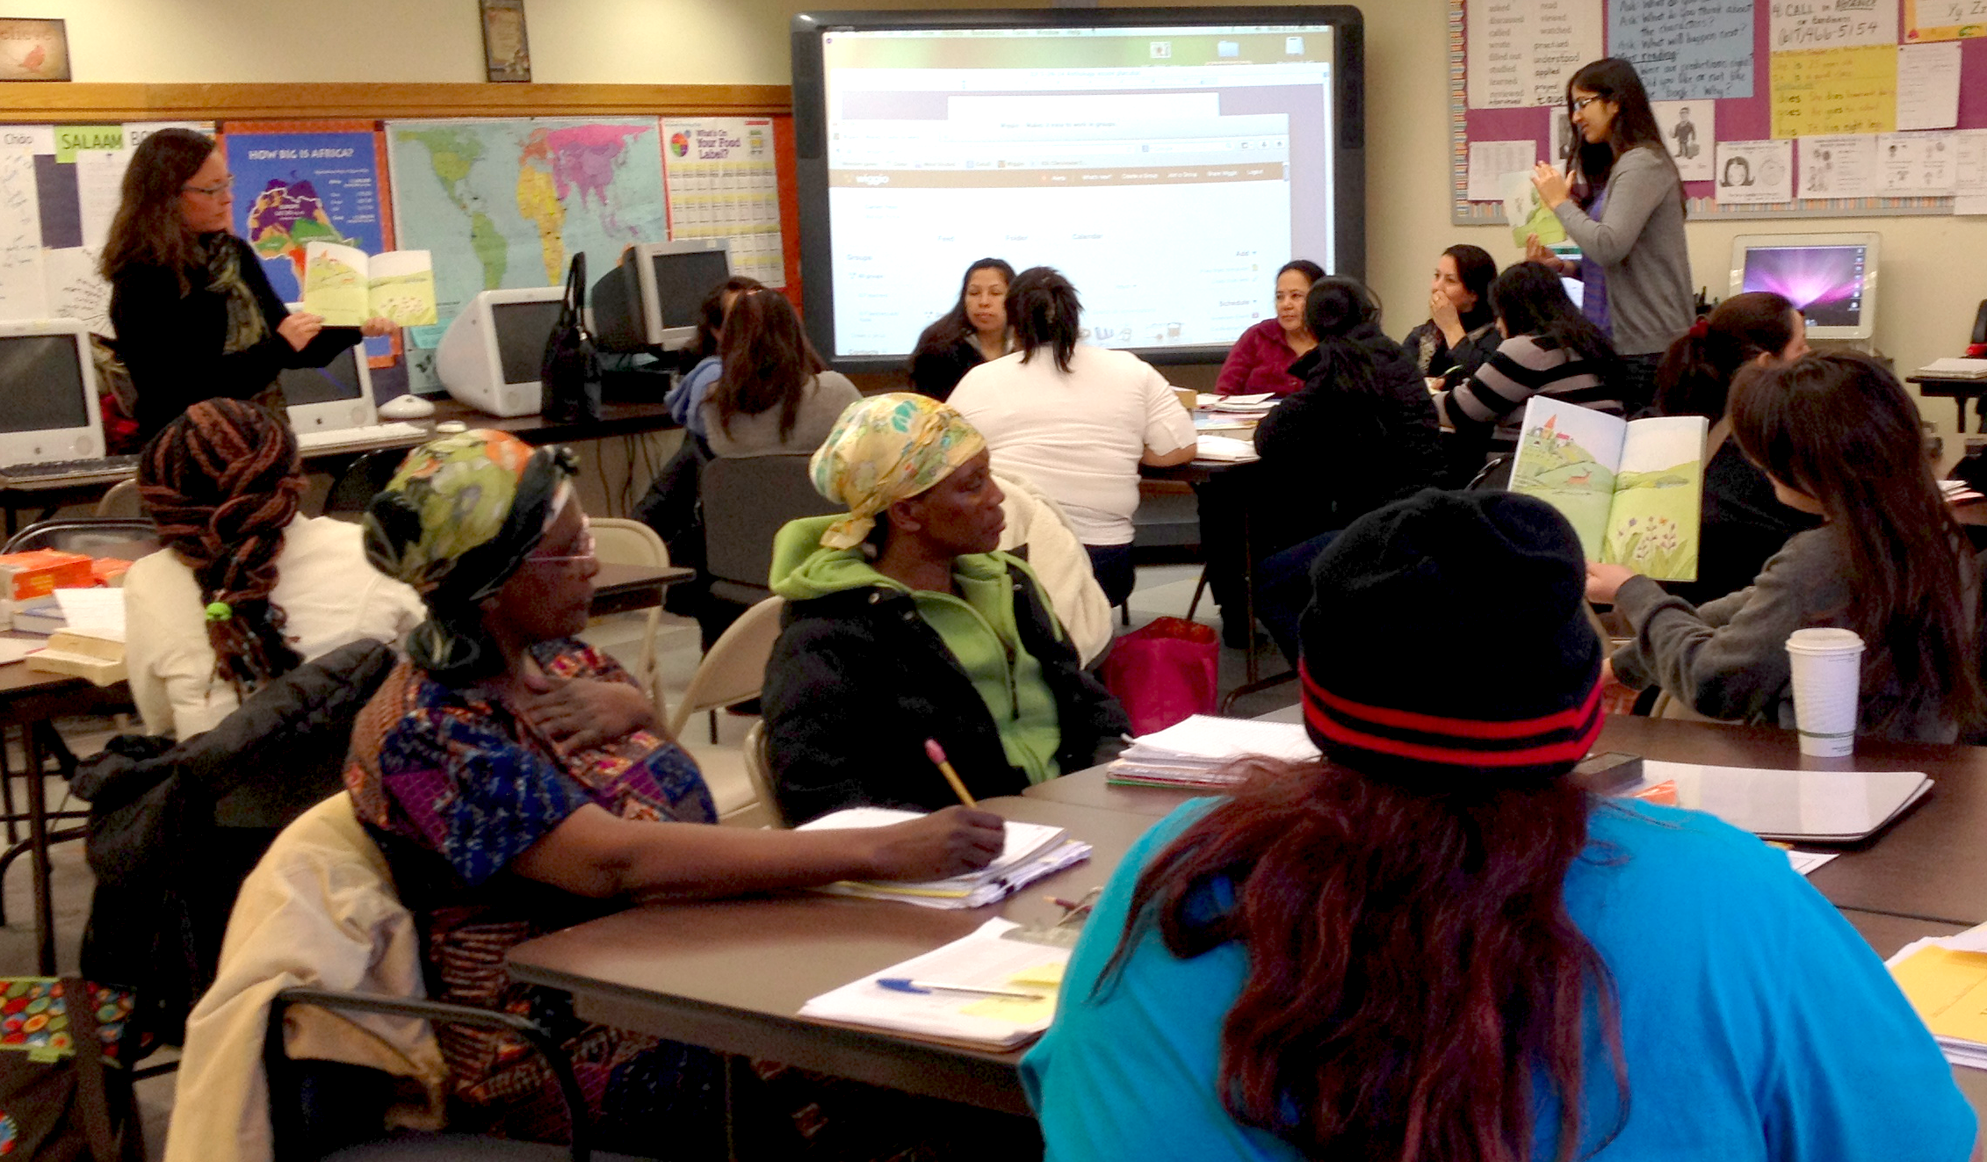
Activity ideas: Book of the Week

Slide 22
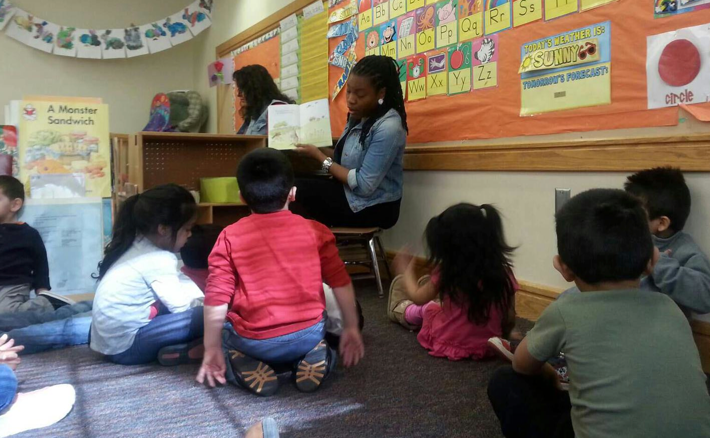
Activity ideas: Book of the Week
Notes:
Brown Bear movie (42 seconds) practicing the book of the week
Fatuma-Muday movie (18 seconds) learning vocabulary in book, but ALSO vocabulary for encouraging her child (“Good job”)
Introduce and show ILP learner interviews video

Slide 23
Wrap-up
Any questions? Comments?
Contact us:
feke07@bu.edu (Falon)
tomitae@chelseaschools.com (Emily)
www.chelseaschools.com/ilp

